Slide 1

Analyzing U.S. Crime Data

Slide 2
TABLE OF CONTENTS
Data Collection and Cleaning
Exploratory Analysis
Answering Questions
Hypothesis Testing
Regression Analysis
ML Models

Slide 3

01.
Data Collection and Cleaning

Slide 4
National Crime Victimization Survey (NCVS)
Key Information:
- Primary source for understanding U.S. criminal victimization.
- Surveys 240,000 individuals annually for a representative sample.
Coverage:
- Explores frequency, characteristics, and consequences of crime.
- Includes nonfatal personal crimes and property crimes, reported or not.
Accessing Data:
- NCVS Select datasets offer curated variables.
- Available through the National Archive of Criminal Justice Data.
Datasets:
- Personal Population: Demographics of all respondents. Regardless of whether they reported a personal crime victimization, are included in this file.
- Personal Victimization: Focuses on reported personal crimes in the U.S.
- Other datasets: - Recidivism data for the state of Georgia [2013-2015]
- Firearm laws per state.
Data Collection:
- Records from 1993-2021.
- Victimizations counted in the year of interview.

Slide 5
Data Wrangling
- DDL APIs was used to get most of the datasets using wget() and gdown() libraries.
- Data cleaning was done generally by known methods,and some modifications for each stage separately depending on needs.
- Label to values transformation depending on codebook and label encoding was done for textual datasets.

Slide 6
02.
Exploratory Analysis

Slide 7
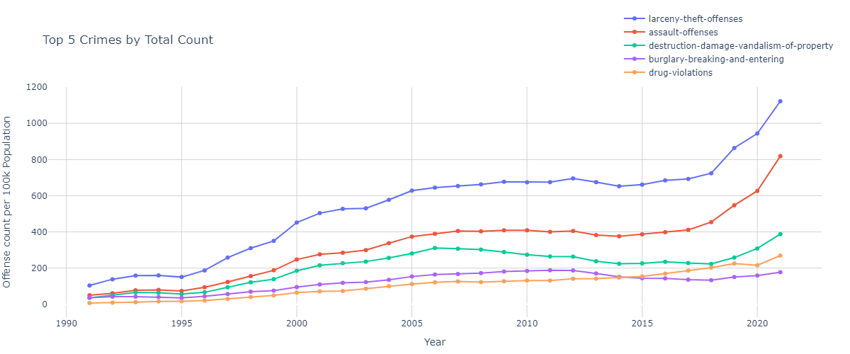
Larceny-Theft-Offenses are the top offenses all over the years.
Reasons: It’s easiest type of crime

Slide 8
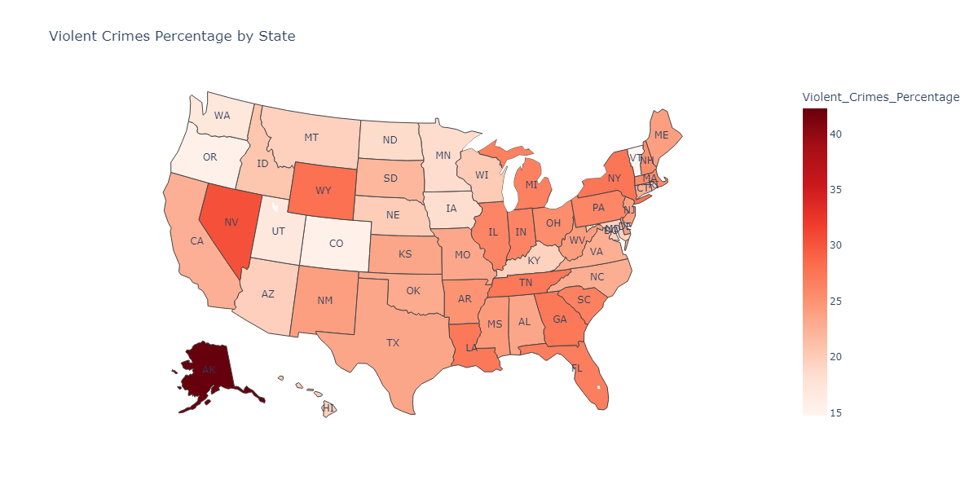
Alaska has the highest rate in violent crimes.
Reasons:
- Many Heavy drinkers in the state
- Considerable distances between locations

Slide 9
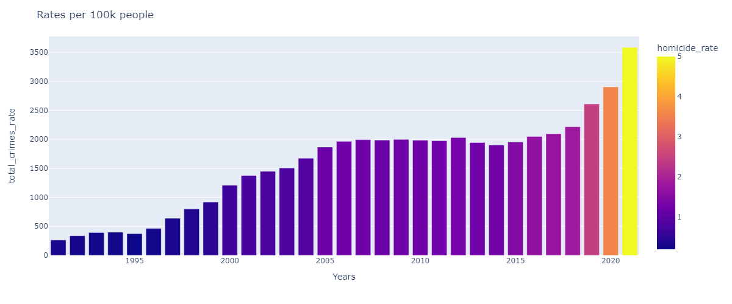
Homicide rates have increased rapidly over the last 3 years.
Reasons for that:
Pandemic stress - The civic upheaval that followed George Floyd's murder
Crime rates in the period of 1991 to 1996 are relatively small.
The reasons for that is: the system was in the early stage, not all offices were using it.

Slide 10
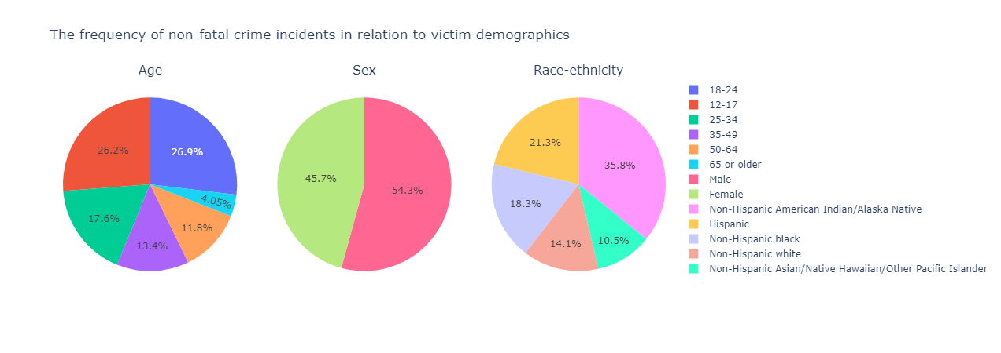
Q4
Of all victims of non-fatal crimes who suffer an injury, which demographic is the most likely to receive medical attention at the scene? Which is the least likely?
The purpose of pie charts is to depict demographics in different scenarios. I divided the number of reported personal crimes in the U.S. by the demographics of all respondents, regardless of victimization, for a more realistic interpretation and mapping of real-world data.

Slide 11
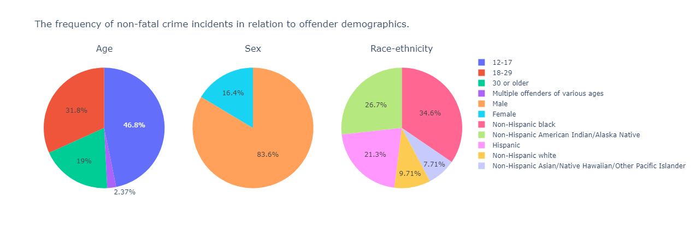
Q5
Which class of crimes is associated with the highest rate of same-offense-recidivism; i.e. prison re-entry for the same offense within 3 years of release?

Slide 12
03.
Answering Questions

Slide 13
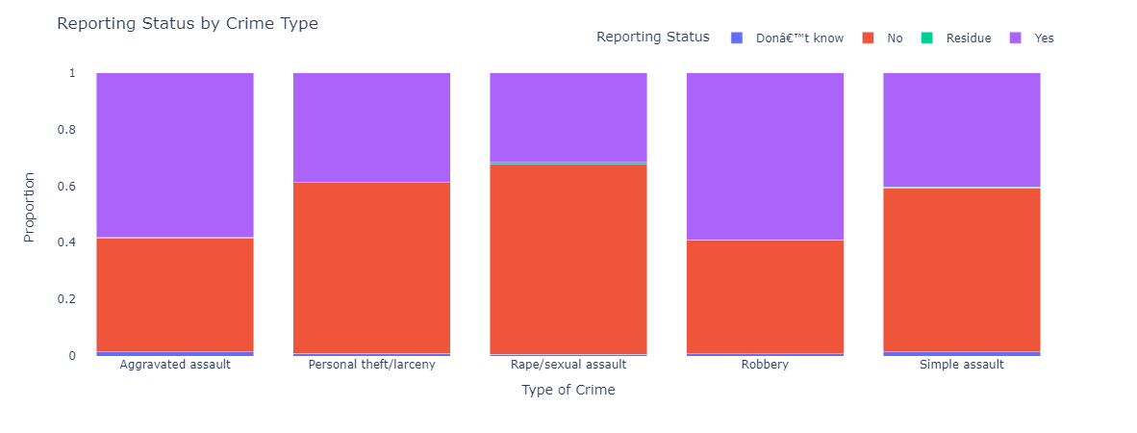
Q1: Which type of non-fatal crime is the most under-reported?

Slide 14
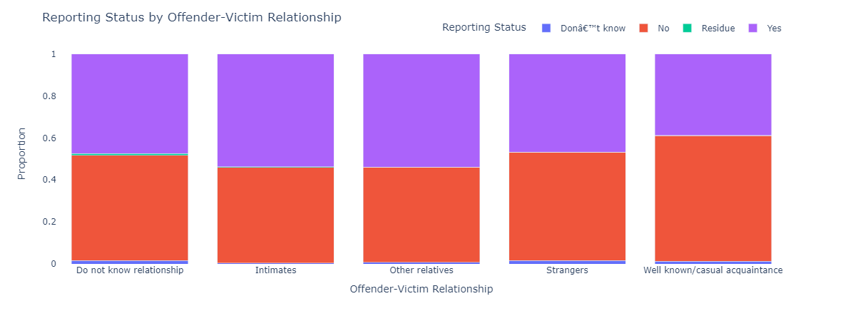
Q1: Is there an association between the offender-victim relationship and the likelihood of a crime being reported?

Slide 15
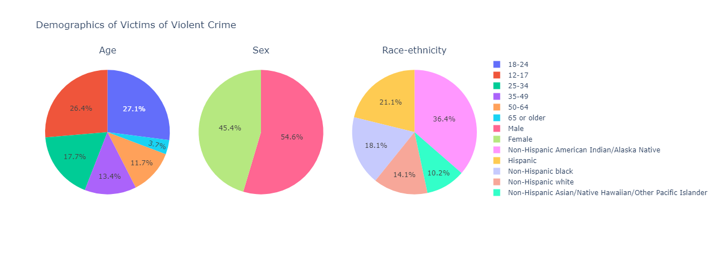
Q2
Who are the people (the demographic segment) that appear to be most at risk of violent victimization? Who is the least at risk?

Slide 16
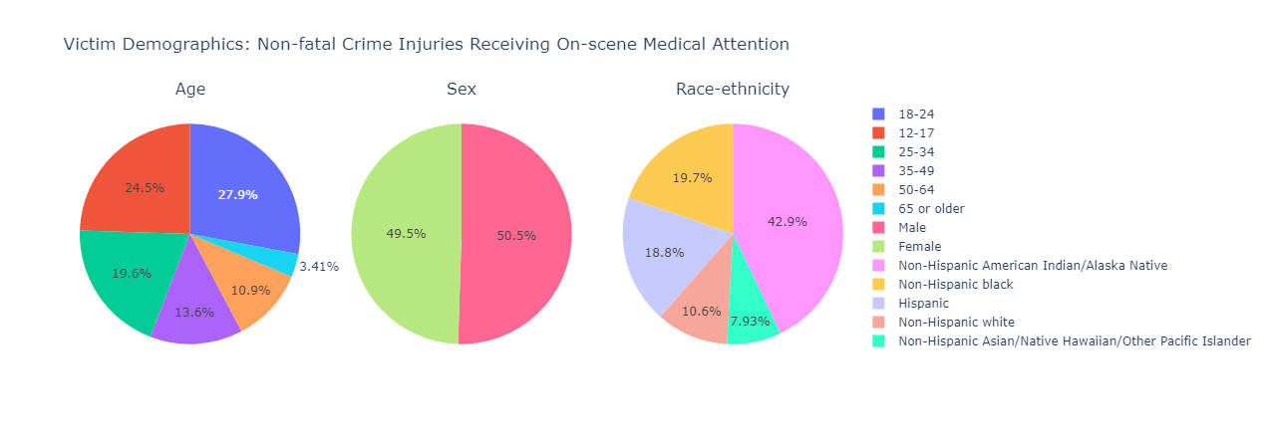
Q3
Of all victims of non-fatal crimes who suffer an injury, which demographic is the most likely to receive medical attention at the scene? Which is the least likely?

Slide 17
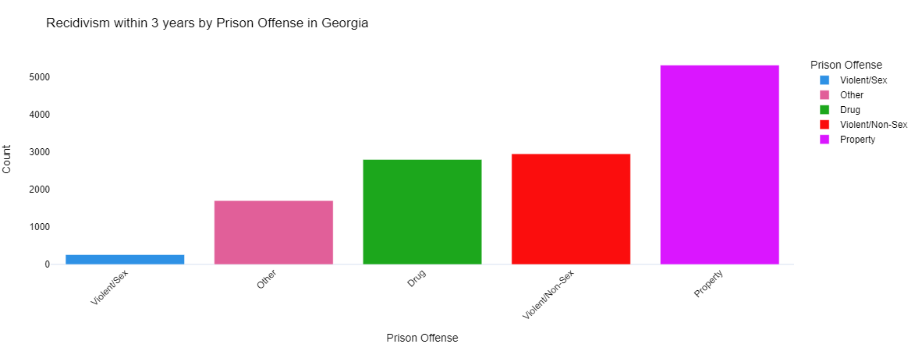
Q4
Which class of crimes is associated with the highest rate of same-offense-recidivism; i.e. prison re-entry for the same offense within 3 years of release?

Slide 18
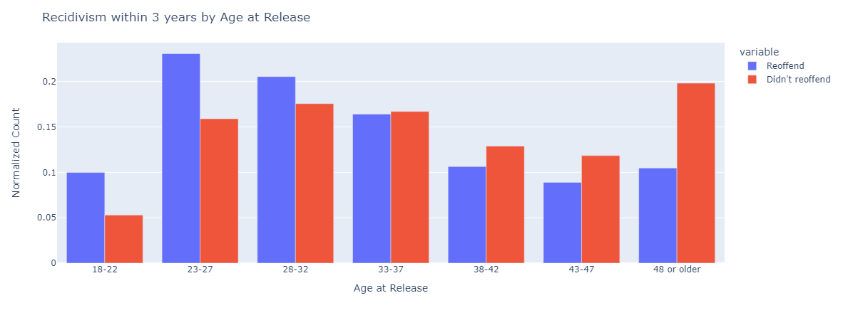
Q5
Are prisoners who are younger at the time of release more or less likely to reoffend than those who are older?

Slide 19
04.
Hypothesis Testing

Slide 20
The hypothesis being tested is:
"U.S. states that implement stricter firearm control laws have lower violent crime rates on average."

Slide 21
Analysis Methodology
Data Extraction:
Relevant data for the last 10 years (2010-2020) was extracted from two datasets:
fire_lawsdf: Information about firearm control laws
offensecountdf: Information about offense counts
Data was extracted for each year from 2010 to 2020.
Hypothesis Testing:
A t-test was performed to compare offense counts between states with stricter firearm control laws and those with less strict laws over the last 10 years.
The p-value obtained from the t-test was used to determine the significance of the relationship between firearm control laws and violent crime rates.

Slide 22
Results
P-value for the Last 10 Years: 0.383
The obtained p-value suggests that there isn't strong statistical evidence to reject the null hypothesis over the last 10 years.
Thus, there isn't sufficient evidence to support the claim that U.S. states with stricter firearm control laws have lower violent crime rates on average over this period.

Slide 23
05.
Regression Analysis

Slide 24
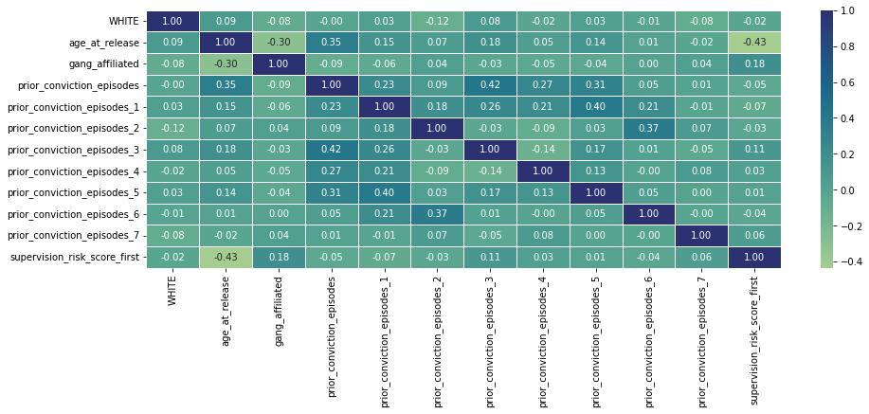

Slide 25
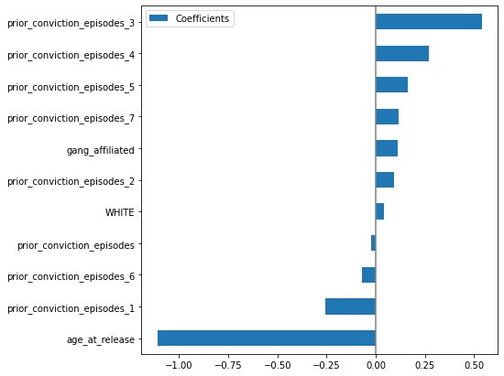
Training R2: 0.24870531231493
Test R2: 0.24401992046393

Slide 26
06.
ML Models

Slide 27
Model Categories
1. Dimensionality Reduction Models + a classifier:
These models employ techniques to reduce feature dimensionality while retaining crucial information.
2. Feature Selection Models + a classifier:
Focused on selecting pertinent features while discarding redundant or correlated ones.

Slide 28
Dimensionality Reduction plus Classifier
1. Pipeline Setup: Begins with StandardScaler for feature normalization, ensuring uniformity across features.
2. Dimensionality Management: using PCA and UMAP to reduce dimensionality while keeping valuable information
3. Classifier Integration: Incorporating Random Forest and Gradient Boosting classifiers to leverage ensemble learning for robust predictions.
4. Hyperparameter Tuning: RandomizedSearchCV facilitates efficient hyperparameter optimization, complemented by cross-validation to improve model generalization.

Slide 29
 | Best Parameters | Training Accuracy | Test Accuracy
Model 1 [PCA with Random Forest] | - PCA Components: 20 - Random Forest Estimators: 100 - Random Forest Min Samples Split: 5 - Random Forest Max Depth: 30 | 99.96% | 97.12%
Model 2 [PCA with Gradient Boosting] | - PCA Components: 20 - Gradient Boosting Estimators: 5 - Gradient Boosting Max Depth: 20 | 98.51% | 92.55%
Model 3 [UMAP with Random Forest] | - UMAP Components: 20 - UMAP Neighbors: 30 - Random Forest Min Samples Split: 2 - Random Forest Max Depth: 20 | 100% | 93.28%

Slide 30
Feature Selection Methods plus Classifier
1. Recursive Feature Elimination (RFE): Prioritizes feature selection based on importance to model performance, further refining the feature set.
2. Correlation-based Feature Elimination: Subsequent utilization of Variance Inflation Factor (VIF) identifies and eliminates correlated features, enhancing model stability and interpretability.
3. Efficiency and Simplicity: These models offer lower computational complexities compared to their dimensionality reduction counterparts, ensuring suitability for scenarios prioritizing interpretability and computational efficiency.

Slide 31
 | Best Parameters | Training Accuracy | Test Accuracy
Model 4 [RFE with Random Forest] | - Number of features selected: 40 - Number of Random Forest Estimators: 50 - Random Forest Max Depth: 4 | 99.26% | 99.45%
Model 5 [RFE with XGBoosting] | - Number of features selected: 40 - Number of XGBoosting Estimators: 12 - XGBoosting Max Depth: 1 | 100% | 100%

Slide 32
THANKS :)

